Slide 1
Team LFTCLK
Engine Proof
By Abhijit Zala, Chris Fitch, Rohit Punjabi, and Vance Howald

Slide 2
Roles
Producer and Audio: Chris
Engine Design: Vance
Graphics: Abhijit
Design and Scripting: Rohit

Slide 3


Game Concept 1
Top-Down Abrasive Shooter
Antithesis to Matrix/Max Payne action
Intense blown out gun sound effects
High bullet spray rate

Slide 4
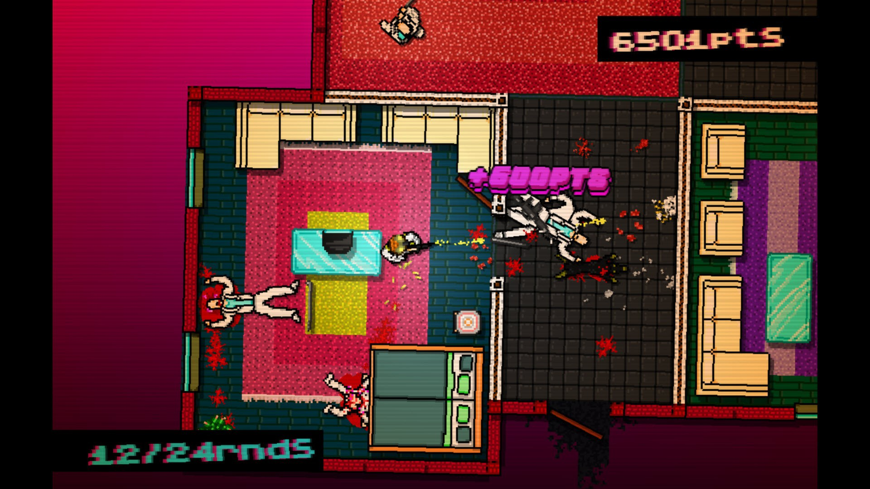
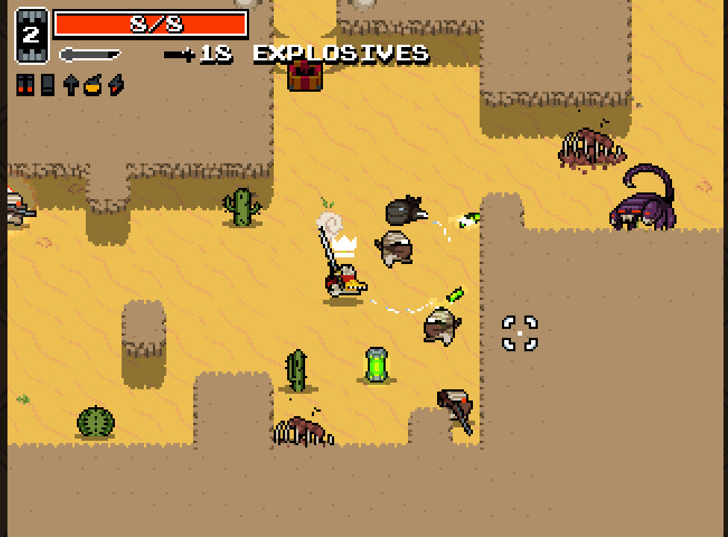
Game Concept 1
Top-Down Abrasive Shooter
Antithesis to Max Payne/Matrix action
Intense blown out gun sound effects
Wider level to move around
Clearing linear levels of enemies
Enemies are shadowy people to avoid M rating
High bullet spray rate

Slide 5

Game Concept 2
Top-Down Rhythm Shooter
Shooting enemies as they come up to the beat
Getting more points for chains
Success based on points gained out of possible points

Slide 6

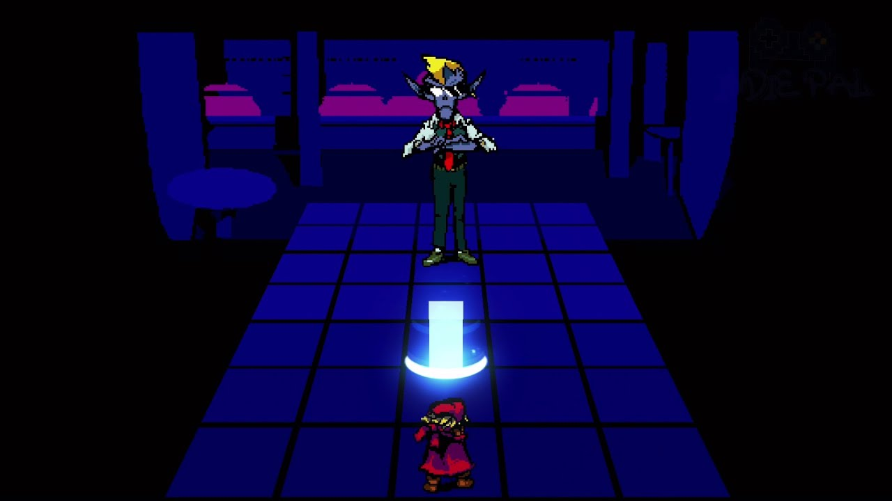
Game Concept 3
Top-Down Rhythm Dodger
Obstacles appear in your path
Perfect dodging nets you more points
If you’re hit you lose health, and if you lose enough you “lose” the song

Slide 7
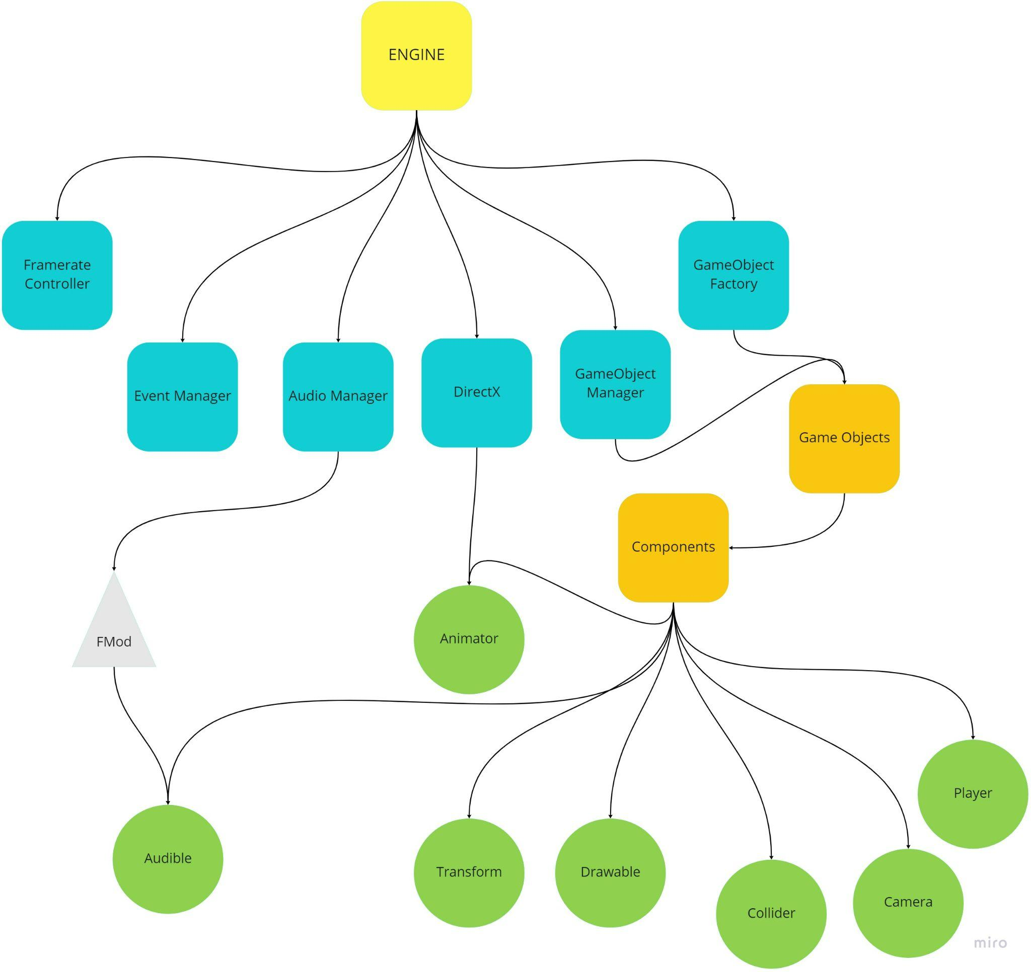
Engine Diagram

Slide 8
DEMO TIME!

Slide 9
Graphics
We are using DirectX 11 for rendering
Graphics Manager abstracts the initialization of the API and contains device (used for resource creation), immediate device context (used for setting pipeline states and drawing), and swapchain (used for presenting frames)
Drawable component contains the mesh data (vertex buffer, index buffer, texture and render states) & accesses Graphics Manager for state creation and drawing

Slide 10
Physics
We’re using rectangle-to-rectangle collision, as none of our concepts will require anything more taxing than that.
Objects subscribe to collision messages in their respective scripts
Each frame collision is processed and collision message sent out
If object intersects use delta vector
No forces (not needed)

Slide 11
Audio
At first I started learning Wwise, but pivoted to FMOD after a few weeks.
FMOD is easier to learn and there are more learning resources for custom engines.
After more research I decided to just use the FMOD Core API.
The Audio Manager sits in front of FMOD’s API and abstracts much of the functionality.
The Audible component reads data on what files to load and how to load them, such as if a sound should loop, should be compressed, and what events the sound should start and stop on.

